Slide 1

This sprawling look at the martian landscape surrounding the Mars Exploration Rover Spirit is the first 3-D stereo image from the rover's navigation camera. A surface depression nicknamed "Sleepy Hollow" can be seen to center left of the image.
Return to Menu Next Slide

Slide 2
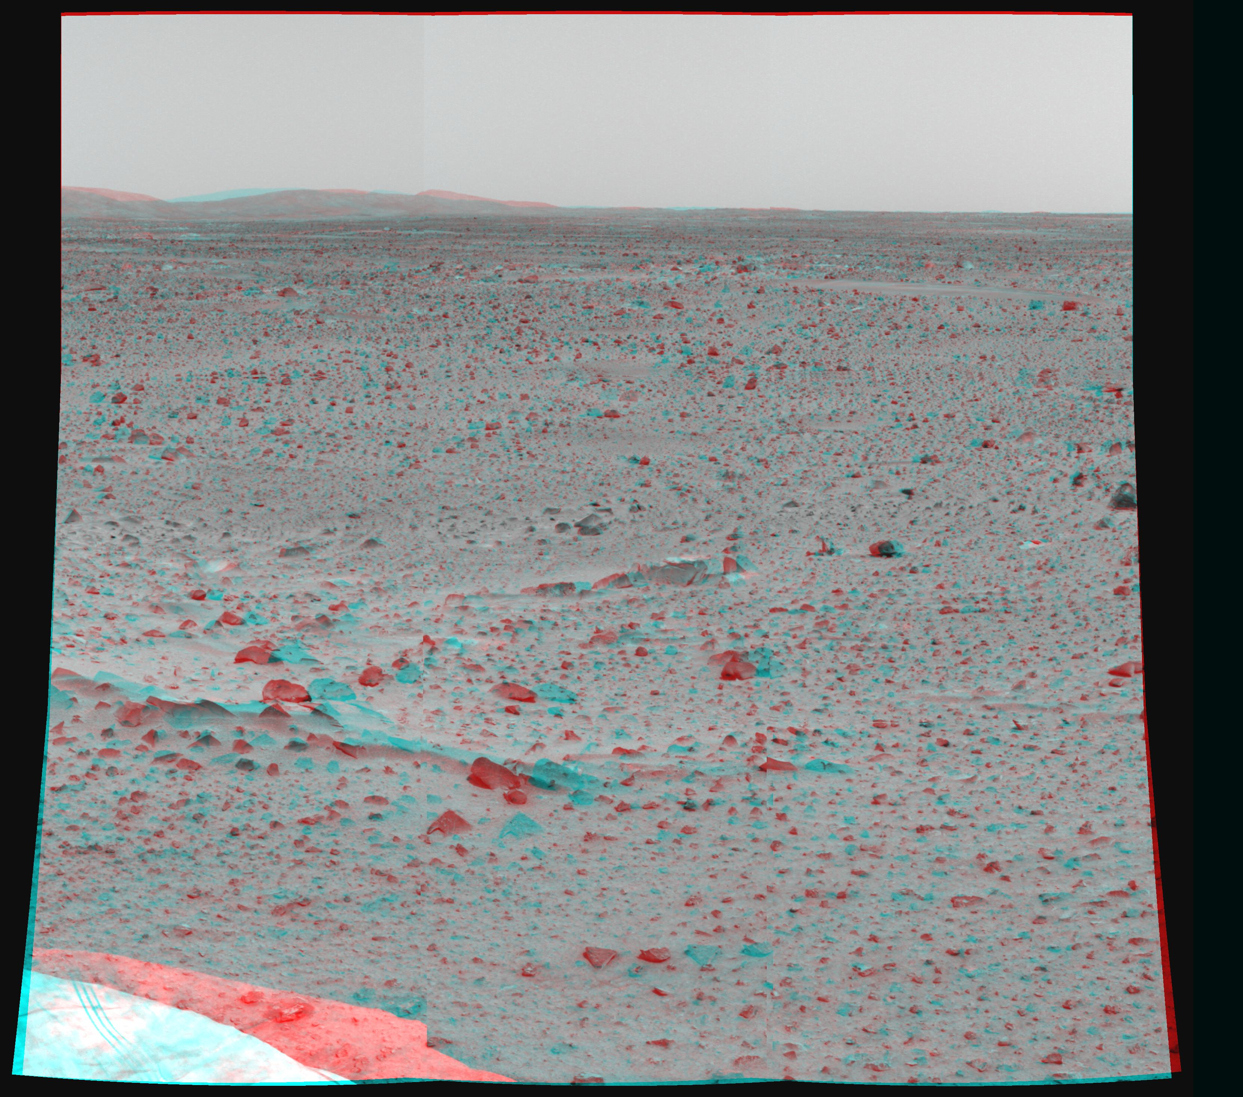
This image shows the martian terrain in 3-D. The Mars Exploration Rover Spirit captured the image with its two high-resolution stereo panoramic cameras.
Return to Menu Previous Slide Next Slide

Slide 3

This image shows Spirit moving toward the first rock target, seen in the foreground. The football-sized rock was dubbed Adirondack because of its mountain-shaped appearance.
Return to Menu Previous Slide Next Slide

Slide 4
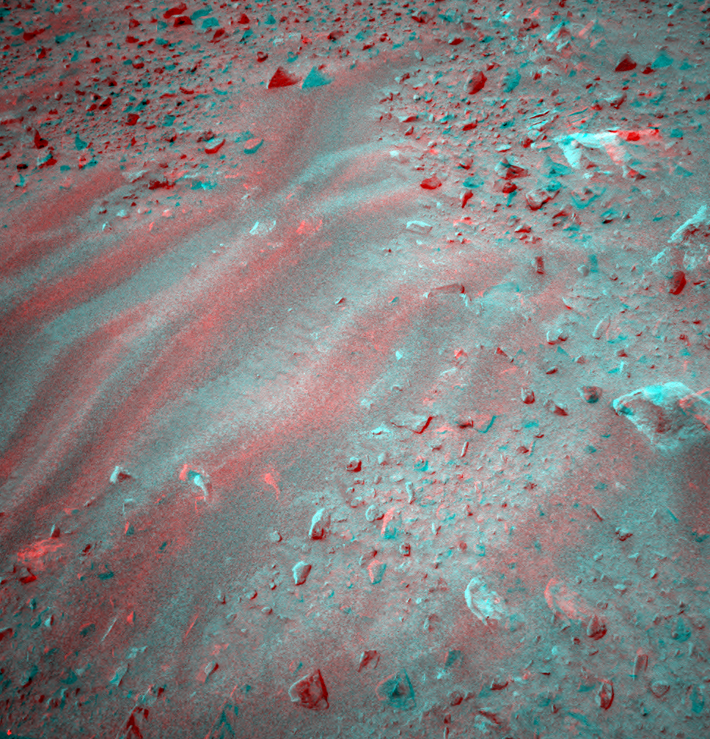
This is a three-dimensional image taken by the camera onboard the Mars Exploration Rover Spirit, showing an interesting patch of rippled soil. Scientists plan to investigate this interesting location with the microscopic imager and Mössbauer spectrometer on Spirit's “arm.”
Return to Menu Previous Slide Next Slide

Slide 5
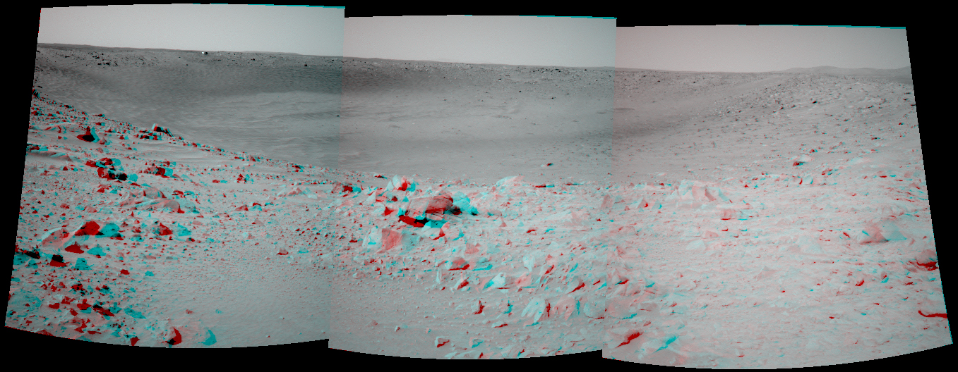
The Mars Exploration Rover Spirit took this 3-D picture of the crater called "Bonneville." Just above the far crater rim, on the left side, is the rover's heatshield, which is visible as a tiny reflective speck.
Return to Menu Previous Slide

